Slide 1
Stacks
Stack: what is it?
ADT
Applications
Implementation(s)

Slide 2

What is a stack?
Stores a set of elements in a particular order
Stack principle: LAST IN FIRST OUT
= LIFO
It means: the last element inserted is the first one to be removed
Example
Which is the first element to pick up?

Slide 3
Last In First Out
B
A
C
B
A
D
C
B
A
E
D
C
B
A
top
D
C
B
A
top
top
top
A
top

Slide 4

Stack Applications
Real life
  Pile of books
  Plate trays
More applications related to computer science
  Program execution stack
  Evaluating expressions

Slide 5
objects: a finite ordered list with zero or more elements. methods: for all stack ∈ Stack, item ∈ element, max_stack_size
∈ positive integer
Stack createS(max_stack_size) ::= create an empty stack whose maximum size is max_stack_size
Boolean isFull(stack, max_stack_size) ::= if (number of elements in stack == max_stack_size) return TRUE else return FALSE
Stack push(stack, item) ::= if (IsFull(stack)) stack_full else insert item into top of stack and return
Stack ADT

Slide 6
Boolean isEmpty(stack) ::= if(stack == CreateS(max_stack_size)) return TRUE else return FALSE
Element pop(stack) ::= if(IsEmpty(stack)) return else remove and return the item on the top of the stack.
Stack ADT (cont’d)

Slide 7
Array-based Stack Implementation
Allocate an array of some size (pre-defined)
  Maximum N elements in stack
Bottom stack element stored at element 0
last index in the array is the top
Increment top when one element is pushed, decrement after pop

Slide 8
Stack createS(max_stack_size) ::=
#define MAX_STACK_SIZE 100 /* maximum stack size */ typedef struct { int key;
/* other fields */
} element; element stack[MAX_STACK_SIZE]; int top = -1;
Boolean isEmpty(Stack) ::= top< 0;
Boolean isFull(Stack) ::= top >= MAX_STACK_SIZE-1;
Stack Implementation:
CreateS, isEmpty, isFull

Slide 9
void push(int top, element item)
{
/* add an item to the global stack */ if (top >= MAX_STACK_SIZE-1) { stack_full( ); return;
} stack[++top] = item;
}
Push

Slide 10
element pop(int top)
{
/* return the top element from the stack */ if (top == -1) return stack_empty( ); /* returns and error key */ return stack[(top)--];
}
Pop

Slide 11
void push(pnode top, element item)
{
/* add an element to the top of the stack */ pnode temp =(pnode) malloc (sizeof (node)); if (IS_FULL(temp)) { printf(stderr, “ The memory is full\n”); exit(1);
} temp->item = item; temp->next= top; top= temp;
}
List-based Stack Implementation: Push

Slide 12
element pop(pnode top) {
/* delete an element from the stack */ pnode temp = top; element item; if (IS_EMPTY(temp)) { printf(stderr, “The stack is empty\n”); exit(1);
} item = temp->item; top = temp->next; free(temp); return item;
}
Pop

Slide 13
Algorithm Analysis
push O(?)
pop O(?)
isEmpty O(?)
isFull O(?)
What if top is stored at the beginning of the array?

Slide 14
A Legend
The Towers of Hanoi
In the great temple of Brahma in Benares, on a brass plate under the dome that marks the center of the world, there are 64 disks of pure gold that the priests carry one at a time between these diamond needles according to Brahma's immutable law: No disk may be placed on a smaller disk. In the begging of the world all 64 disks formed the Tower of Brahma on one needle. Now, however, the process of transfer of the tower from one needle to another is in mid course. When the last disk is finally in place, once again forming the Tower of Brahma but on a different needle, then will come the end of the world and all will turn to dust.

Slide 15


The Towers of Hanoi
A Stack-based Application
  GIVEN: three poles
  a set of discs on the first pole, discs of different sizes, the smallest discs at the top
  GOAL: move all the discs from the left pole to the right one.
  CONDITIONS: only one disc may be moved at a time.
  A disc can be placed either on an empty pole or on top of a larger disc.

Slide 16

Towers of Hanoi

Slide 17

Towers of Hanoi

Slide 18

Towers of Hanoi

Slide 19

Towers of Hanoi

Slide 20

Towers of Hanoi

Slide 21

Towers of Hanoi

Slide 22
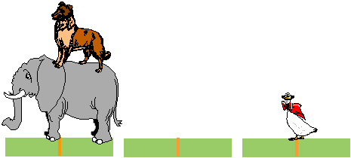
Towers of Hanoi

Slide 23
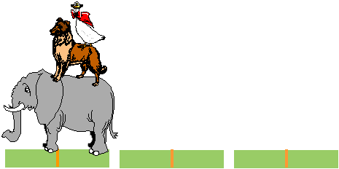
Towers of Hanoi

Slide 24
Towers of Hanoi – Recursive Solution
void hanoi (int discs,
Stack fromPole,
Stack toPole,
Stack aux) {
Disc d;
if( discs >= 1) {
hanoi(discs-1, fromPole, aux, toPole);
d = fromPole.pop();
toPole.push(d);
hanoi(discs-1,aux, toPole, fromPole);
}

Slide 25
Applications
Infix to Postfix conversion
[Evaluation of Expressions]

Slide 26
Is the End of the World Approaching?
Problem complexity 2^{n}
64 gold discs
Given 1 move a second

Slide 27
X = a / b - c + d * e - a * c a = 4, b = c = 2, d = e = 3
Interpretation 1:
((4/2)-2)+(3*3)-(4*2)=0 + 8+9=1
Interpretation 2:
(4/(2-2+3))*(3-4)*2=(4/3)*(-1)*2=-2.66666…
How to generate the machine instructions corresponding to a given expression? precedence rule + associative rule
Evaluation of Expressions

Slide 28
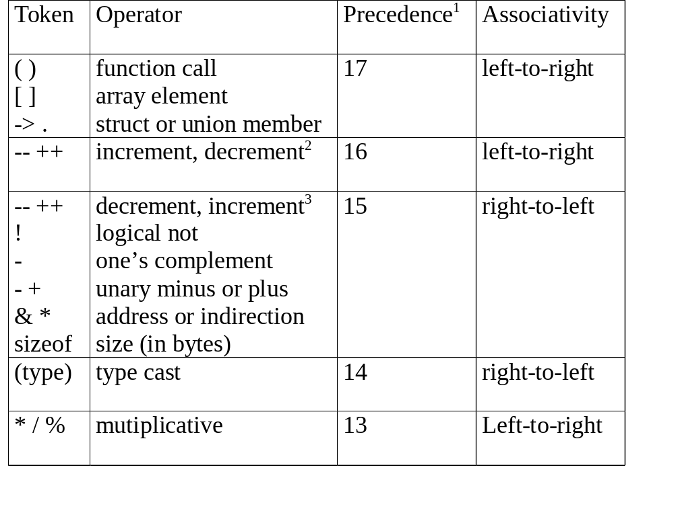

Slide 29
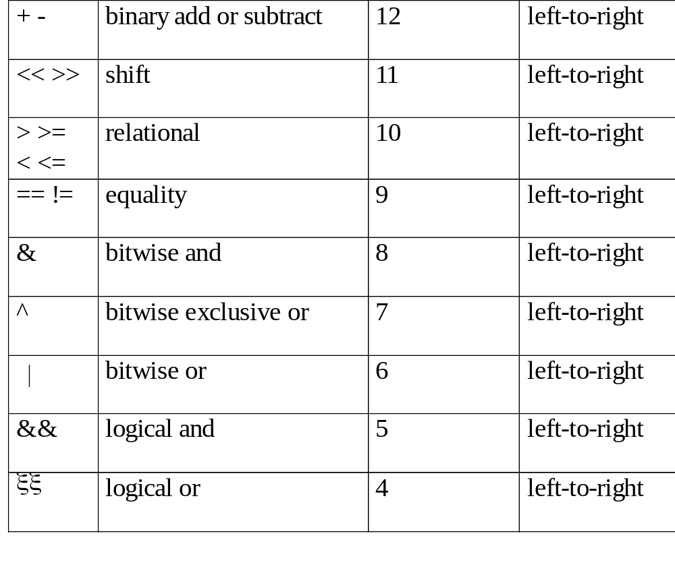

Slide 30
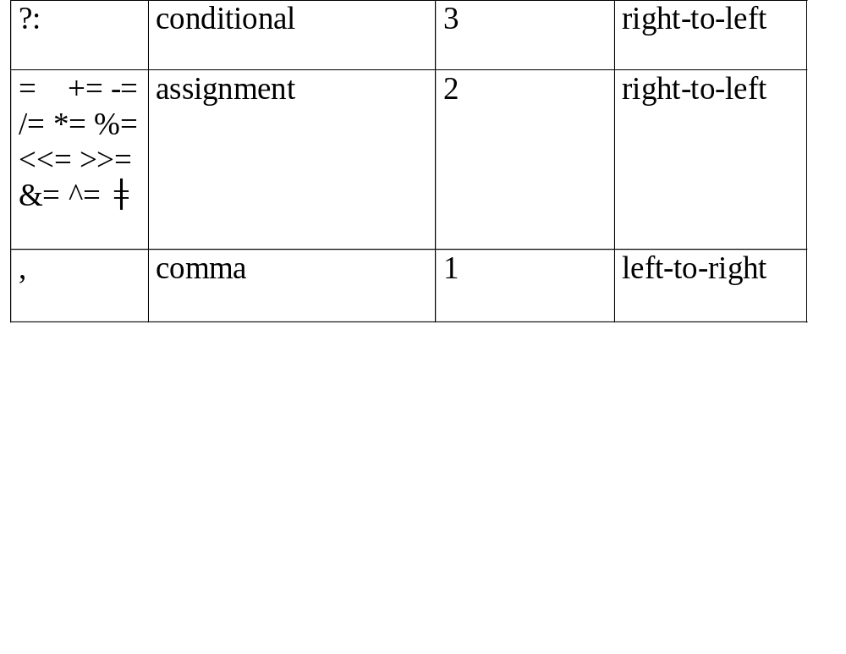

Slide 31
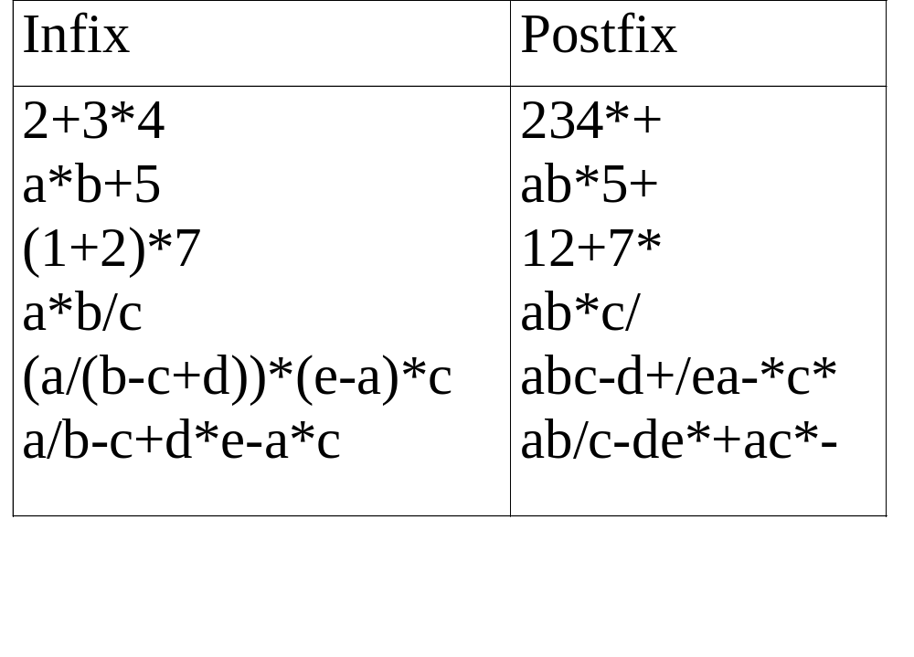
user
compiler
Postfix: no parentheses, no precedence

Slide 32
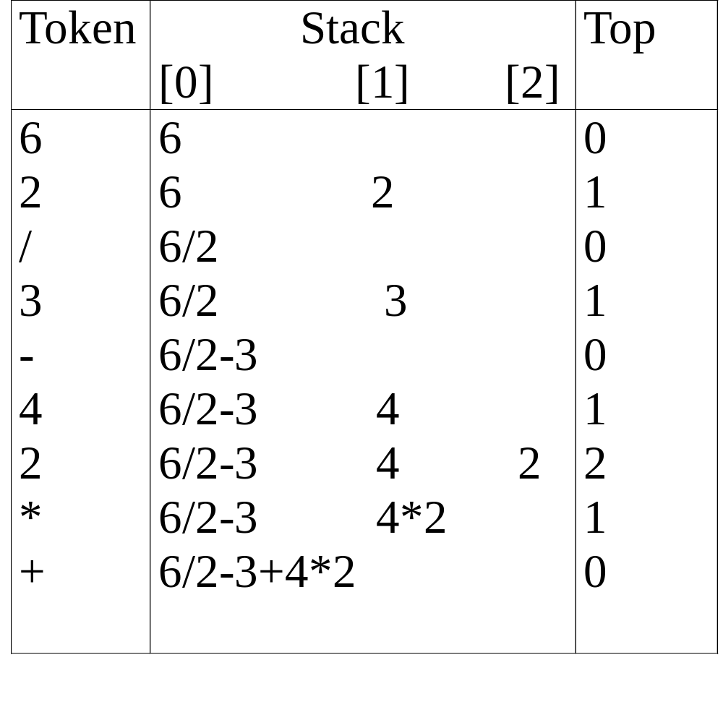

Slide 33
#define MAX_STACK_SIZE 100 /* maximum stack size */
#define MAX_EXPR_SIZE 100 /* max size of expression */ typedef enum{1paran, rparen, plus, minus, times, divide, mod, eos, operand} precedence; int stack[MAX_STACK_SIZE]; /* global stack */ char expr[MAX_EXPR_SIZE]; /* input string */
Infix to Postfix
Assumptions:
operators: +, -, *, /, %
operands: single digit integer

Slide 34
int eval(void)
{
/* evaluate a postfix expression, expr, maintained as a global variable, ‘\0’ is the the end of the expression.
The stack and top of the stack are global variables. get_token is used to return the token type and the character symbol. Operands are assumed to be single character digits */ precedence token; char symbol; int op1, op2; int n = 0; /* counter for the expression string */ int top = -1; token = get_token(&symbol, &n); while (token != eos) { if (token == operand) push(&top, symbol-’0’); /* stack insert */
Evaluation of Postfix Expressions

Slide 35
else { /* remove two operands, perform operation, and return result to the stack */ op2 = pop(&top); /* stack delete */ op1 = pop(&top); switch(token) { case plus: push(&top, op1+op2); break; case minus: push(&top, op1-op2); break; case times: push(&top, op1*op2); break; case divide: push(&top, op1/op2); break; case mod: push(&top, op1%op2);
}
} token = get_token (&symbol, &n);
} return pop(&top); /* return result */
}

Slide 36
precedence get_token(char *symbol, int *n)
{
/* get the next token, symbol is the character representation, which is returned, the token is represented by its enumerated value, which is returned in the function name */
*symbol =expr[(*n)++]; switch (*symbol) { case ‘(‘ : return lparen; case ’)’ : return rparen; case ‘+’: return plus; case ‘-’ : return minus;

Slide 37
case ‘/’ : return divide; case ‘*’ : return times; case ‘%’ : return mod; case ‘\0‘ : return eos; default : return operand;
/* no error checking, default is operand */
}
}

Slide 38
Infix to Postfix Conversion
(Intuitive Algorithm)
(1) Fully parenthesized expression
a / b - c + d * e - a * c -->
((((a / b) - c) + (d * e)) – (a * c))
(2) All operators replace their corresponding right
parentheses.
((((a / b) - c) + (d * e)) – (a * c))
(3) Delete all parentheses.
ab/c-de*+ac*-
two passes
/
-
+
*
-
*

Slide 39
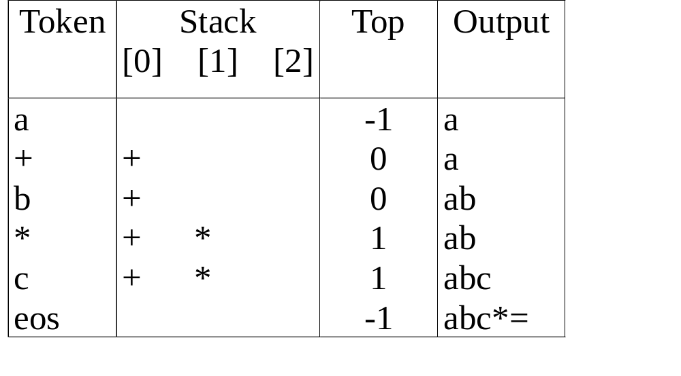
The orders of operands in infix and postfix are the same.
a + b * c, * > +

Slide 40
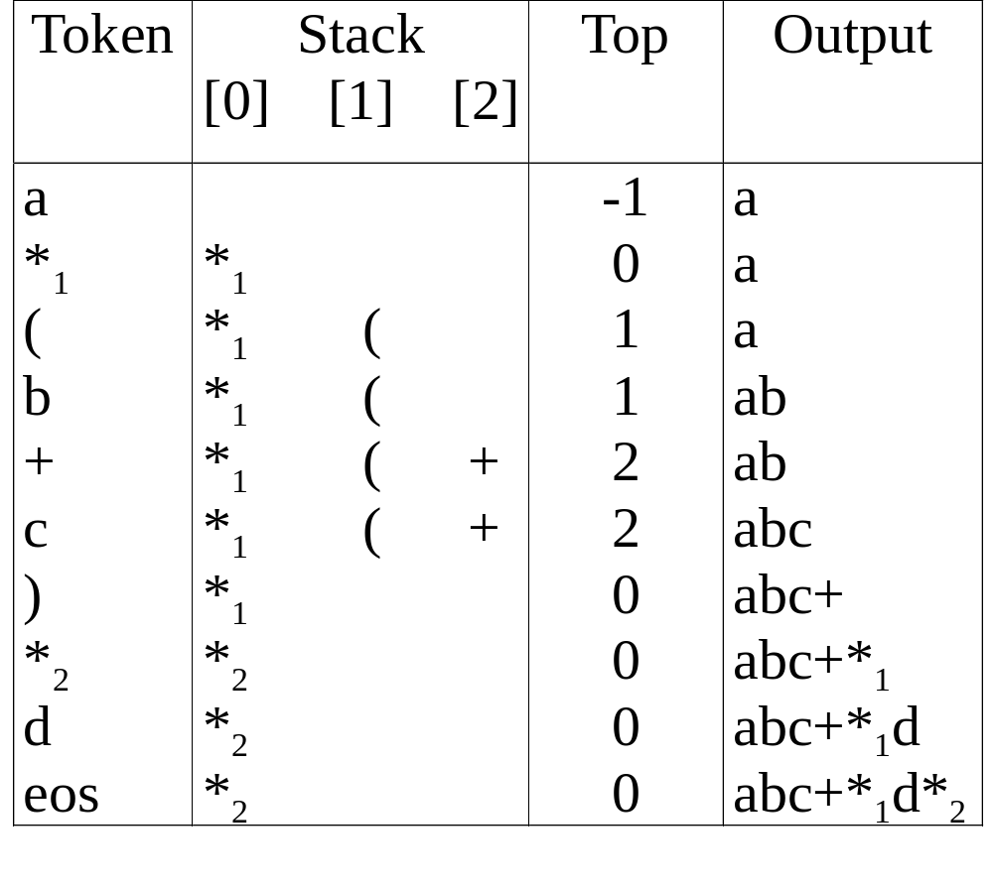
a *₁ (b +c) *₂ d
match )
*₁ = *₂

Slide 41
Rules
(1) Operators are taken out of the stack as long as their
in-stack precedence is higher than or equal to the
incoming precedence of the new operator.
(2) ( has low in-stack precedence, and high incoming
precedence.
( ) + - * / % eos
isp 0 19 12 12 13 13 13 0
icp 20 19 12 12 13 13 13 0

Slide 42
precedence stack[MAX_STACK_SIZE];
/* isp and icp arrays -- index is value of precedence lparen, rparen, plus, minus, times, divide, mod, eos */ static int isp [ ] = {0, 19, 12, 12, 13, 13, 13, 0}; static int icp [ ] = {20, 19, 12, 12, 13, 13, 13, 0};
isp: in-stack precedence
icp: incoming precedence

Slide 43
void postfix(void)
{
/* output the postfix of the expression. The expression string, the stack, and top are global */ char symbol; precedence token; int n = 0; int top = 0; /* place eos on stack */ stack[0] = eos; for (token = get _token(&symbol, &n); token != eos; token = get_token(&symbol, &n)) { if (token == operand) printf (“%c”, symbol); else if (token == rparen ){
Infix to Postfix

Slide 44
/*unstack tokens until left parenthesis */ while (stack[top] != lparen) print_token(delete(&top)); pop(&top); /*discard the left parenthesis */
} else{
/* remove and print symbols whose isp is greater than or equal to the current token’s icp */ while(isp[stack[top]] >= icp[token] ) print_token(delete(&top)); push(&top, token);
}
} while ((token = pop(&top)) != eos) print_token(token); print(“\n”);
}
Infix to Postfix (cont’d)

Slide 45
Queue
Stores a set of elements in a particular order
Stack principle: FIRST IN FIRST OUT
= FIFO
It means: the first element inserted is the first one to be removed
Example
The first one in line is the first one to be served
cinemark

Slide 46
Queue Applications
Real life examples
  Waiting in line
  Waiting on hold for tech support
Applications related to Computer Science
  Threads
  Job scheduling (e.g. Round-Robin algorithm for CPU allocation)

Slide 47
First In First Out
A
B
A
C
B
A
D
C
B
A
rear
front
D
C
B
rear
front
rear
front
rear
front
rear
front

Slide 48
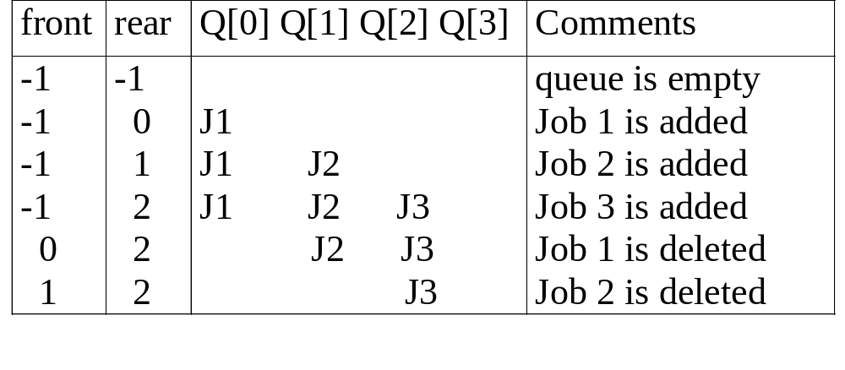
Applications: Job Scheduling

Slide 49
objects: a finite ordered list with zero or more elements. methods: for all queue ∈ Queue, item ∈ element, max_ queue_ size ∈ positive integer
Queue createQ(max_queue_size) ::= create an empty queue whose maximum size is max_queue_size
Boolean isFullQ(queue, max_queue_size) ::= if(number of elements in queue == max_queue_size) return TRUE else return FALSE
Queue Enqueue(queue, item) ::= if (IsFullQ(queue)) queue_full else insert item at rear of queue and return queue
Queue ADT

Slide 50
Boolean isEmptyQ(queue) ::= if (queue ==CreateQ(max_queue_size)) return TRUE else return FALSE
Element dequeue(queue) ::= if (IsEmptyQ(queue)) return else remove and return the item at front of queue.
Queue ADT (cont’d)

Slide 51
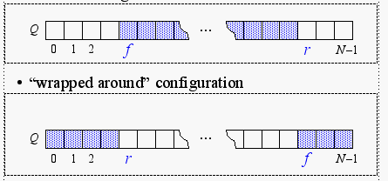
Array-based Queue Implementation
As with the array-based stack implementation, the array is of fixed size
  A queue of maximum N elements
Slightly more complicated
  Need to maintain track of both front and rear
Implementation 1
Implementation 2

Slide 52
Queue createQ(max_queue_size) ::=
# define MAX_QUEUE_SIZE 100/* Maximum queue size */ typedef struct { int key;
/* other fields */
} element; element queue[MAX_QUEUE_SIZE]; int rear = -1; int front = -1;
Boolean isEmpty(queue) ::= front == rear
Boolean isFullQ(queue) ::= rear == MAX_QUEUE_SIZE-1
Implementation 1:
createQ, isEmptyQ, isFullQ

Slide 53
void enqueue(int *rear, element item)
{
/* add an item to the queue */ if (*rear == MAX_QUEUE_SIZE_1) { queue_full( ); return;
} queue [++*rear] = item;
}
Implementation 1:
enqueue

Slide 54
element dequeue(int *front, int rear)
{
/* remove element at the front of the queue */ if ( *front == rear) return queue_empty( ); /* return an error key */ return queue [++ *front];
}
Implementation 1:
dequeue

Slide 55
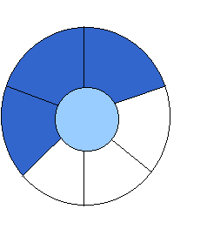
Implementation 2:
Wrapped Configuration
EMPTY QUEUE
[2]
[3] [2] [3]
J2
J3
[1] [4] [1] [4]
J1
[0] [5] [0] [5]
front = 0 front = 0
rear = 0 rear = 3
Can be seen as a circular queue

Slide 56

Leave one empty space when queue is full
Why?
FULL QUEUE FULL QUEUE
[2] [3] [2] [3]
J2 J3
J8 J9
J7
[1] [4][1] [4]
J1 J4
J5
J6 J5
[0] [5] [0] [5]
front =0
rear = 5
front =4
rear =3
How to test when queue is empty?
How to test when queue is full?

Slide 57
void enqueue(int front, int *rear, element item)
{
/* add an item to the queue */
*rear = (*rear +1) % MAX_QUEUE_SIZE; if (front == *rear) /* reset rear and print error */ return;
} queue[*rear] = item;
}
Enqueue in a Circular Queue

Slide 58
element dequeue(int* front, int rear)
{ element item;
/* remove front element from the queue and put it in item */ if (*front == rear) return queue_empty( );
/* queue_empty returns an error key */
*front = (*front+1) % MAX_QUEUE_SIZE; return queue[*front];
}
Dequeue from Circular Queue

Slide 59
List-based Queue Implementation: Enqueue
void enqueue(pnode &front, pnode rear, element item)
{ /* add an element to the rear of the queue */
pnode temp =
(pnode) malloc(sizeof (queue));
if (IS_FULL(temp)) {
fprintf(stderr, “ The memory is full\n”);
exit(1);
}
temp->item = item;
temp->next= NULL;
if (front) { (rear) -> next= temp;}
else front = temp;
rear = temp; }

Slide 60
Dequeue
element dequeue(pnode &front) {
/* delete an element from the queue */
pnode temp = front;
element item;
if (IS_EMPTY(front)) {
fprintf(stderr, “The queue is empty\n”);
exit(1);
}
item = temp->item;
front = temp->next;
free(temp);
return item;
}

Slide 61
Algorithm Analysis
enqueue O(?)
dequeue O(?)
size O(?)
isEmpty O(?)
isFull O(?)
What if I want the first element to be always at Q[0] ?

